Slide 1
Introduction to OOP

Slide 2
Introduction to OOP
It is a programming paradigm that organizes software design around objects rather than functions or logic.
Procedural programming is about writing procedures or methods that perform operations on the data, while object-oriented programming is about creating objects that contain both data and methods.

Slide 3
Why OOP?
OOP is faster and easier to execute
OOP provides a clear structure for the programs
OOP helps to keep the Java code DRY "Don't Repeat Yourself", and makes the code easier to maintain, modify and debug
OOP makes it possible to create full reusable applications with less code and shorter development time

Slide 4
What are Classes and Objects?
Class | Object
Car | Car 1 //proton
 | Car 2 //perodua
 | Car 3 //bmw
 | Car 4 //mercedes
Student | Student 1 //ali
 | Student 2 //chen
 | Student 3 //mong
A class is a template for objects, and an object is an instance of a class
Inside a class, you can only declare:
Variables (attributes)
Methods
Constructors

Slide 5
public class CarDealership {
public static void main(String[] args) {
Car car1 = new Car();
Car car2 = new Car();
Car car3 = new Car();
Car car4 = new Car();
car1.brand = "Proton";
car1.color = "Red";
car1.type = "sedan";
car2.brand = "Perodua";
car2.color = "Blue";
car2.type = "sedan";
car3.brand = "BMW";
car3.color = "Black";
car3.type = "SUV";
car4.brand = "Mercedes";
car4.color = "Silver";
car4.type = "Coupe";
car1.showdetails();
car2.showdetails();
car3.showdetails();
car4.showdetails();
}
}
class Car {
String brand;
String color;
String type;
public void showdetails(){
System.out.println("Brand: " + brand);
System.out.println("Color: " + color);
System.out.println("Vehicle Type: " + type);
System.out.println();
}
}

Slide 6
public class University {
public static void main(String[] args) {
Student student1 = new Student();
Student student2 = new Student();
Student student3 = new Student();
student1.name = “Gurmit";
student1.matric = 303766;
student1.age = 22;
student2.name = “Ali";
student2.matric = 1234;
student2.age = 21;
student3.name = “Chen";
student3.matric = 5678;
student3.age = 23;
student1.showdetails();
student2.showdetails();
student3.showdetails();
}
}
class Student {
String name;
int matric;
int age;
public void showdetails(){
System.out.println(“Name: " + name);
System.out.println(“Matric: " + matric);
System.out.println(“Age: " + age);
System.out.println();
}
}

Slide 7
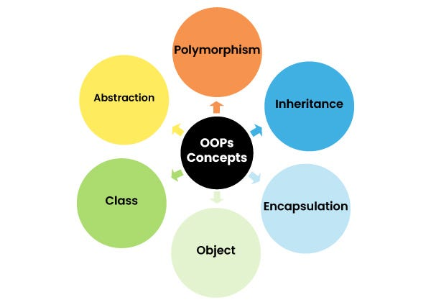
Object Oriented Design

